Slide 1
A Gentle Introduction to CQRS
Peter Ritchie

Slide 2
Peter
Contributed to Microsoft Patterns and Practices “A CQRS Journey”
Help to architect/design/develop several distributed systems using CQRS patterns to various levels.
linkd.in/1fRmZVS

Slide 3
Goals
Introduction
Up to speed on concepts
Won’t be an expert
May know your next steps
At least one resource to draw upon

Slide 4
Notes:
Implementing CQRS isn’t a defined process.
Lot’s of learning and tweaking along the way.
I’ve tried to cherry pick the minimal things that represent a fairly complex app making use of CQRS.

Slide 5
Notes:
Not a linear process.
There’s some empirical process involved.
Defining theory (implicit or explicit)
performing experiences
making decisions
making changes
A presentation is more of a linear process.
Tried to put concepts in conceptually logical linear order
Will most likely be different when you go about it.
Speak up, this is how I view it, if I’m not making sense, let me know.

Slide 6
History
DDD
DDDD
DDD “Distributed”, fit 4th ‘D’ anywhere in “DDD”
Greg Young
Udi Dahan
Eric Evans
Martin Fowler

Slide 7
What is CQRS?
A Pattern
Not an architecture
Command and Query separation
Object-orientation
Notes:
New, still evolving
CQS: Command, Query
Separation to the next level: Segregation
Strict OO
Principle of focus.
CQRS means different things to different people.
This session tries to work with the lessons learned from the P&P CQRS journey
Many of the members of that journey were introduced to DDD during that timeframe, so it can only go so far.

Slide 8
CQS – Command, Query
public class Entity
{
//...
public void Move(string newAddress)
{
//...
}
public string GetAddress()
{
//...
}
}
Notes:
Coined by Bertrand Meyer
`void` command
Query has return value
Query does not change state
Command does change state.

Slide 9
CQS – Command, Query
public class User
{
public string Address { get; private set; }
public void Move(string newAddress)
{
//...
}
}
Notes:
In a .NET environment you may be doing something like this. But, you’re losing a bit of intent about *why* you’re asking for Name
Pedantry.

Slide 10
CQS – Command, Query
public class User
{
public string Address { get; set; }
}
Yuck!
Notes:
No intent.
Are you “correcting” an error with a name?
Are you “changing” a name?

Slide 11
CQRS
public class UserWriteService
{
// Commands
public void Move(User user, string newAddress);
//...
}
public class UserReadService
{
// Queries
public User GetUser(int userId);
//...
}

Slide 12
WAT?
Notes:
The topic of CQRS really I about what possibilities this segregation offers.
In order to do that we need to recognize some related patterns and principles that let us implement this segregation across the architecture.

Slide 13
Possibilities!
Notes:
The topic of CQRS really I about what possibilities this segregation offers.
Reduces accidental restrictions through the promotion of explicitness and separation of concerns.
In order to do that we need to recognize some related patterns and principles that let us implement this segregation across the architecture.
Object orientation: abstraction, abstraction, encapsulation.

Slide 14
Command
Message
Handler changes state
Returns void (nothing)
Might have parameters
Notes:
What we’ve seen so far are implicit commands.
CQRS uses most specifically the Command Message Pattern.
Well-known pattern
Makes *intent of change* explicit
Not just a ChangeRecordCommand
A “correct address” task—which technically identical—is separate from a “move” task
Different from MVVM and ICommand—which occurs at view model layer

Slide 15
Command
public class MoveCustomerCommand : Command
{
public Address NewAddress { get; set; }
}

Slide 16
Query
Does not change state
Has return value
Might have parameters
Also a type of message
Notes:
The opposite of a Command is query
Gets state, does not change state.

Slide 17
Complexity
Notes:
Addresses complexities.
Complexities of separation of concerns

Slide 18
Notes:
Application Services – BLL
DTOs, View Models
About data between components
MVVM separate: VM DTOs, commands, etc. all independent.

Slide 19
DDD
CQRS is based on DDD
DDD to address complexity
Aggregate Roots
Bounded Contexts
Domain Events
Notes:
Essential part of DDD
Specifically addresses domain complexities
Principles:
Intention-revealing
Side-effect free functions
Clear encapsulation

Slide 20
Ubiquitous Language
Domain experts
Technical team
Share language
Model based on the shared language

Slide 21
Entities
Have identity
Like User
Notes:
Encapsulation of data that includes identity (ID, etc.)

Slide 22
Value objects
Have value, no identity
Like Address

Slide 23
Aggregates and their Root
An aggregate of one or more Entities and Value objects
One Entity is the Root that is used to reference the aggregate
Conceptual boundary by root
Consistency boundary
transactional
Notes:
A consistency boundary
Has identity, rather than value.
Introduction of Entity/Value type just to describe aggregates

Slide 24
Bounded Context
Two or more distinct (obviously related) models
Interactions between them
Usually delineated by business groups or tasks
Sometimes explicit, sometimes evolution step
Notes:
Order, reservation, payment

Slide 25
Domain Event
Represents something that happened in the past
Immutable
Historical record
Notes:
Simple but important aspect of DDD as well as CQRS
Kind of got lost in the original DDD information but has gotten much more recognition.
I believe Evans views the lack of coverage of events in the DDD book is biggest mistake.
Martin Fowler recognizing the pattern

Slide 26
Architecture influenced by CQRS

Slide 28
Read vs. Write Model
Abstractions
Difference in frequency
Flexibility of consistency
Strong and eventual consistency
Notes:
Separation of concerns.
With the read side and the write side of the system we can now reason about each independent of one another
Optimizations of each can be applied based on scenario.

Slide 29
Scalability
Separation of read model from write model
Read model can be scaled appropriately
Data replication
Caches
Scaling up
Write model can be scaled appropriately
Scale out business logic

Slide 30
Queues
Decoupling of units of work
Asynchronous
Notes:
Now that we have this philosophy and practice of a thorough degree of abstraction
We have the ability to approach tasks from a decoupled way.
Rather than couple of processing of one item of work with the next item of work within the application
Decouple it to a queue.
Lots of off-the-shelf queues to manage this, RabbitMQ, MSMQ, Azure, 0MQ, etc.
Remember principle of avoid re-inventing the wheel.

Slide 31
Notes:
Example implementation/deployment option
Write work-load scaled out to handle roughly twice the workload

Slide 32
Notes:
Example implementation/deployment option
One option how writes update the read data via events.
Asynchronous production of events so that write layer(s) can proceed at different rates
*Eventual Consistency*

Slide 33
Immutability and Asynchrony
Data sent for external processing cannot change
Principle of immutability all the way down the architecture
Events, Commands, etc. immutable once sent
No thread-safety necessary, no writers

Slide 34
Idempotent
Important as immutability
Asynchronously apply the same change
Safe because the result is the same each time
Queued events
Notes:
Context free
Can be re-applied
Aids in quest to scale out work
Times when events may get re-applied, depending on messaging guarantees.
At-least-once, etc.

Slide 35
Event Sourcing
Rebuilding of domain objects based on stored events.
Not transaction log
Event source helps track intent

Slide 36
Sagas?
Necessary?
Not long-lived transaction
Complex all on their own
Difference from process managers
Notes:
CQRS? What about sagas?
Managed long-running processes involving communication between bounded context
another level of complexity
Only necessary with the complexity of bounded contexts.
Distributed transaction
Locks for duration
Process manager
Coordinates/routes messages between bounded context
Saga
Compensates for failure instead of locks
Example, something that manages going from an order from the orders bounded context to a reservation in the reservation bounded context, to a payment in the payment bounded context

Slide 37
Recommended Practices

Slide 38
Don’t do CQRS for sake of CQRS
DDD
Accidental complexity
Maslow's hammer
Shiny new thing
Notes:
Be proficient in DDD
- could take some time
Don’t jump into CQRS (or DDD for that mater) to create accidental complexity (more)
Don’t go away from this and thing CQRS fits everywhere.
Don’t go away from this and want to use CQRS for the sake of using CQRS.

Slide 39
Don’t start from scratch
Imperfect world
Always address business concerns
Unless you’re lucky to be on a greenfield project
Notes:
Imperfect world: things are broken, need to be fixed incrementally.
DDD and CQRS is about a tight relationship with the business, always keep them in mind.
Greenfield: different story

Slide 40
Task-based UI
Make UI about performing tasks
UI should not be about just data
Make actions explicit
Keep business logic out of the user’s head
Notes:
If you’ve got forms over data (each “entity” has Create, Read, Update, Delete, type actions) CQRS will likely fail.
Can you distribute a system like that? Sure! Can you use a queue and messages and commands, etc? Sure, but that’s not CQRS
The UI should keep and enforce business logic and business process in the UI
Tasks – not business logic in the users head.
Tasks beget commands, commands beget messages, messages beget queues, queues beget scalability, etc.

Slide 41
Addresses distribution complexity
Already distributed
Or need to be distributed
Scalability
Notes:
CQRS kind of depends on some level of distribution
Doesn’t make much sense without it.
System that is already distributed
System that will need to be distributed
End-game: scalability.
Breaks things up into manageable, independent, explicit blocks that can be processed individually and asynchronously.

Slide 42
Many more reads than writes
Commands are where application-specific work is needed.
Scaling reads—already well covered
Notes:
What properties of a system might suggest CQRS is a good idea?
A system with many more reads that writes.
You’ve got a clean delineation of concerns
Don’t want either side (read: reads affect writes) to affect the other directly.
Need to scale effectively (i.e. scale each site optimally).

Slide 43
Decoupling
Asynchronicity
Commands
Class name details intent
immutable
Data is simple (no complex types)
Events
Idempotent
Immutable

Slide 44
Benefits

Slide 45
Historical Data
Storing the data that changed as well as intent.
Can provide business value to future questions
Can “replay” events as new functionality comes online to re-use that intent
Notes:
TODO: Example

Slide 46
More clear separation of data
Production data
Objects
BI Data
Reporting
Notes:
Data fulfils two clear needs
Evolve independently and unrestricted
You now have a reporting-centric side of data.
Application needs it’s own reports (queries).
That data can be used in conjunction with events to provide rich BI data.

Slide 47
Better Scalability
Commands can be scaled differently than reads
Basic queuing patterns
Notes:
Commands, while changing state (writing data), often involve computations. As commands are immutable, decoupled, and independent

Slide 48
Better Scalability
Not just data/processing: team
Ever team members doesn’t have to be a top-to-bottom expert
Separate roles into Domain, Read Model, Client (UX).

Slide 49
Benefits overview
More flexible system
Easier to use system
Infrastructural patterns
Business value focus
Notes:
Gives you infrastructure patterns to build on to help keep focus on business value.
Demands a scientific approach: empirical observations of experiments and making choices based on those observations

Slide 50
Drawbacks

Slide 51
Drawbacks
If not addressing complexity, it adds complexity
Deals with abstracting complexity
Many different patterns
Many different architectural options
Brownfield: redesign
Journeyman/master paradigm
Notes:
Doesn’t
Abstracting complexity, if abstractions don’t hide real complexity they’re adding complexity.
About as scientific and systematic as you can get in software design and architecture.
Demands a scientific approach: empirical observations of experiments and making choices based on those observations

Slide 52
Where to go from here?

Slide 53
Distribution
Many different deployment options.
Logging
Health monitoring
Separation of concerns
Work breakdown

Slide 54
Continued learning
Journeyman
DDD
Queuing systems
Queuing patterns
Master
Affecting architecture from application of CQRS patterns.

Slide 55
Continued learning: Distribution
Idempotency, immutability, actors, etc.
Queues
Availability
Offline/partitioning
Consistency
Strong
Eventual
Notes:
Immutability!
Messaging: idempotency
Actors are a useful background for breaking work up into chunks dealing with immutable data, messaging and goes down a path to idempotency.
Strong consistency: the ACID-all-the-things fallacy.
Make conscious decisions about what does and doesn’t need to be strong or eventual.

Slide 56


References
CQRS Journey - http://lynk.at/1kqXn2A
CQRS/DDD list - http://lynk.at/1fAf1DC

Slide 57
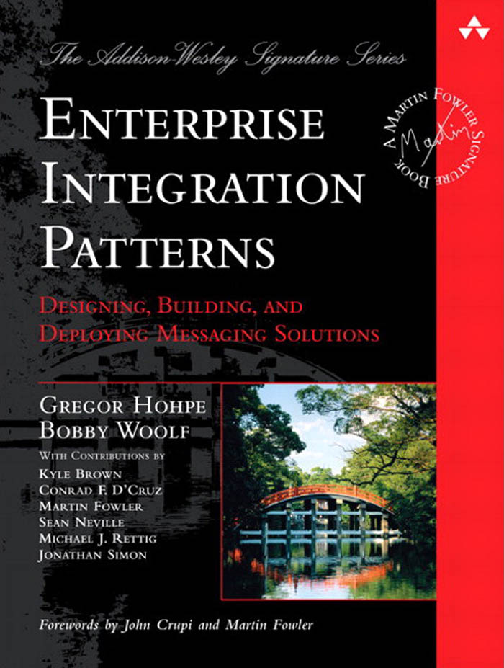
Enterprise Integration Patterns

Slide 58
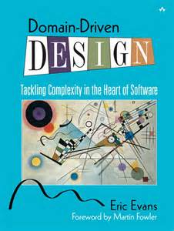
Domain Driven Design
Notes:
Read it, more than once.
First time: serially
Subsequent times: chapter order depends on your circumstances.

Slide 59
Thank you!

Slide 60

Q&A
@peterRitchie
Peter.Ritchie@outlook.com
Blog: http://blog.peterritchie.com

